Slide 1
ESG in Mining: Current Trends and the Need to Transition from Compliance to Sustainable Practices
Workshop on current trends and the need to transition from compliance to sustainable practices
Wouter Jordaan, Principal Consultant (ESG)
Wouter Jordaan (Pr Sci.Nat)
Beijing, China, 16 May 2023

Slide 2
Presentation Topics
The following topics will be discussed
Brief Overview of ESG and Sustainability
Current ESG topics in the Mining Industry
Megatrends we see affecting the mining industry
Changes observed in how mines are changing towards Good International Best Practice
The role of sustainability standards
Financial Benefits and Building Resilience
Questions and Sharing some Learnings
Please open Mentimeter.com on your phone or computer browser to participate in two interactive surveys during the presentation

Slide 3
ESG and Sustainable Development
Responsible sourcing
Responsible finance
Responsible business/ mining
S
U
S
T
A
I
N
A
B
L
E
D
E
V
EL
O
P
M
E
N
T
ESG
Notes:
ESG is at the heart of Responsible Business/Mining, Responsible Sourcing and Responsible Finance. The E, the S and the G are interlinked, if any of those are weak or missing it is likely that it will reflect on the bottom line

Slide 4
How ESG links to Sustainable Development
ESG is the institutional response to sustainable development imperatives

Slide 5
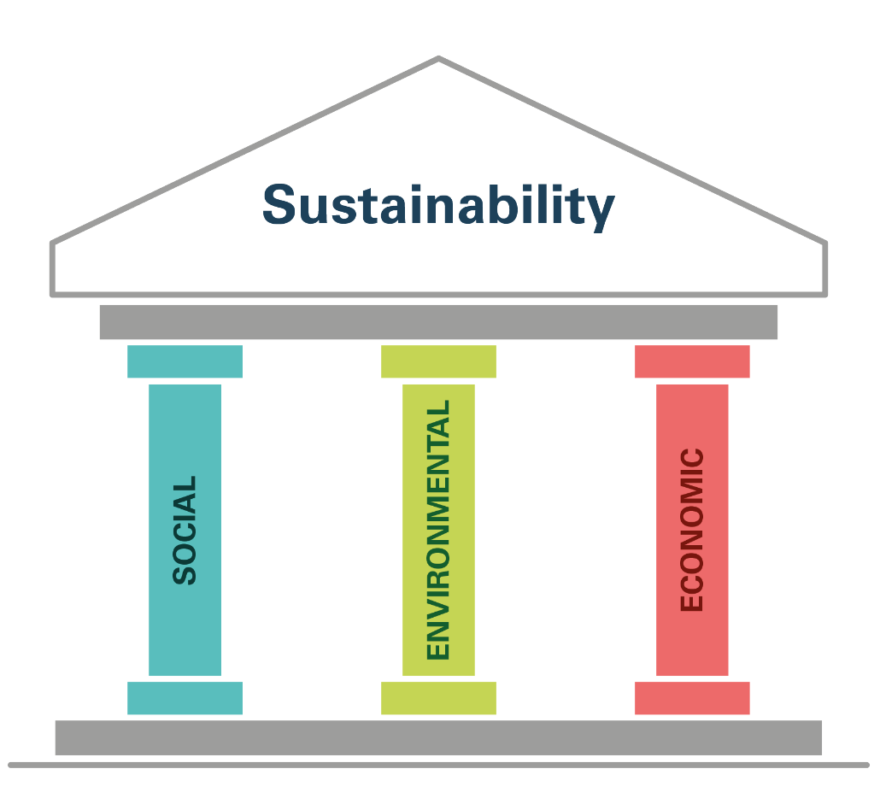
ESG and Sustainability
Term “ESG” has become popular with the strengthening of the economic pillar or sustainability
Emergence of the green economy and shared value business model:
Financier activism – lenders, investors
Shareholder activism
Supply chain activism
Pressure from clients/ customers

Slide 6
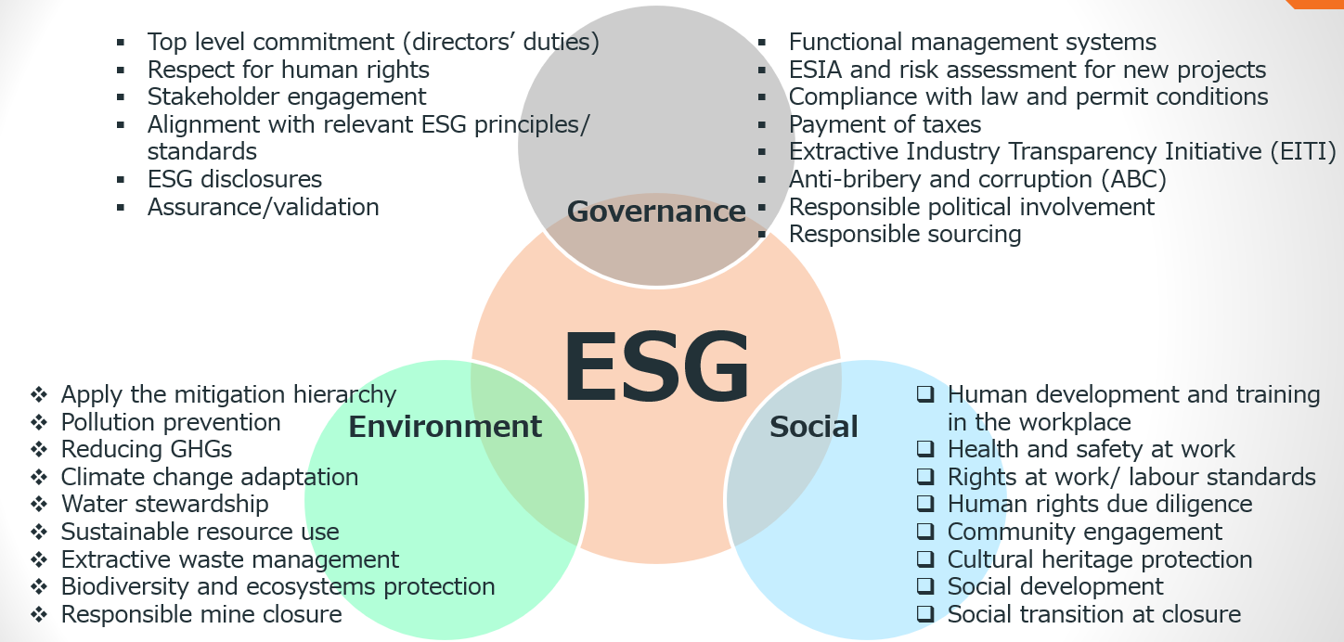
ESG Topics for Mining

Slide 7
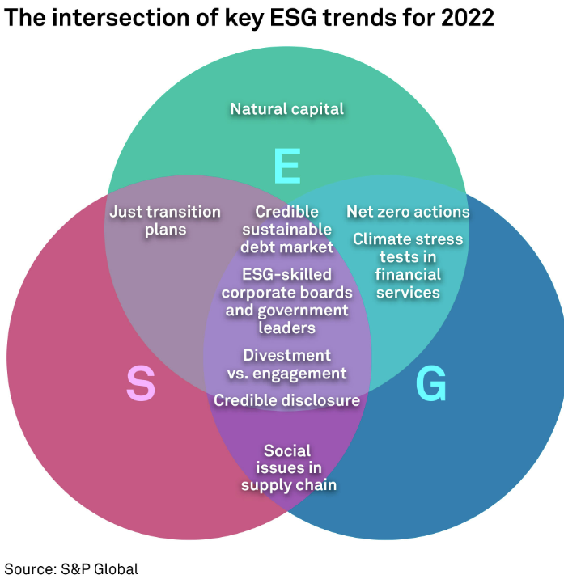
Key ESG trends in 2022

Slide 8
Megatrends Affecting Mines

Slide 9
Mentimeter Question
What are the three biggest ESG challenges your company / mine are facing?

Slide 10
Where Shifts are happening
E&S Permitting, Policy, Due Diligence, CPR’s:
Increase in in-country ESIA’s being benchmarked against international requirements (lender safeguards, standards, internal company policies and commitments)
Local ESIA’s but comprehensive ESMP’s for implementation
Stronger Social requirements, inclusion of sustainability standards, climate change and GHG emission calculations
Air Quality and Climate Change:
Carbon footprint calculations and reporting (climate change risk assessment, mitigation and adaptation plans, carbon offsets).
Link with hydrology – Disaster management flood risk assessments, vulnerability assessments, water security

Slide 11
Where Shifts are happening
Decarbonisation
Technology advances, carbon foot printing and risk assessments –carbon offset strategies and carbon footprint reduction strategies
ESG input into Tailings Facilities (GISTM)
Large portion of GISTM requires a range of ESG inputs
Integrated teams
Social issues and human rights
Mine Closure and Rehabilitation
Transitioning to Social Closure
Climate change impacts on Closure Planning
Closure Maturity Frameworks

Slide 12
Where Shifts are happening
Water Stewardship
Multistakeholder and integrated approach to understand how mines and communities can work together
Sustainability standards for responsible mining and supply chains
Increasing role in lender, supply-chain and transaction DD’s.
Gap assessments and benchmarking
Development of internal sustainability / responsible standards
Adoption of external sustainability / responsible standards

Slide 13
Completely interrelated subjects
Climate change resilience/ adaptation
Water stewardship and mine waste management – (including GISTM)
Responsible mine closure

Slide 14
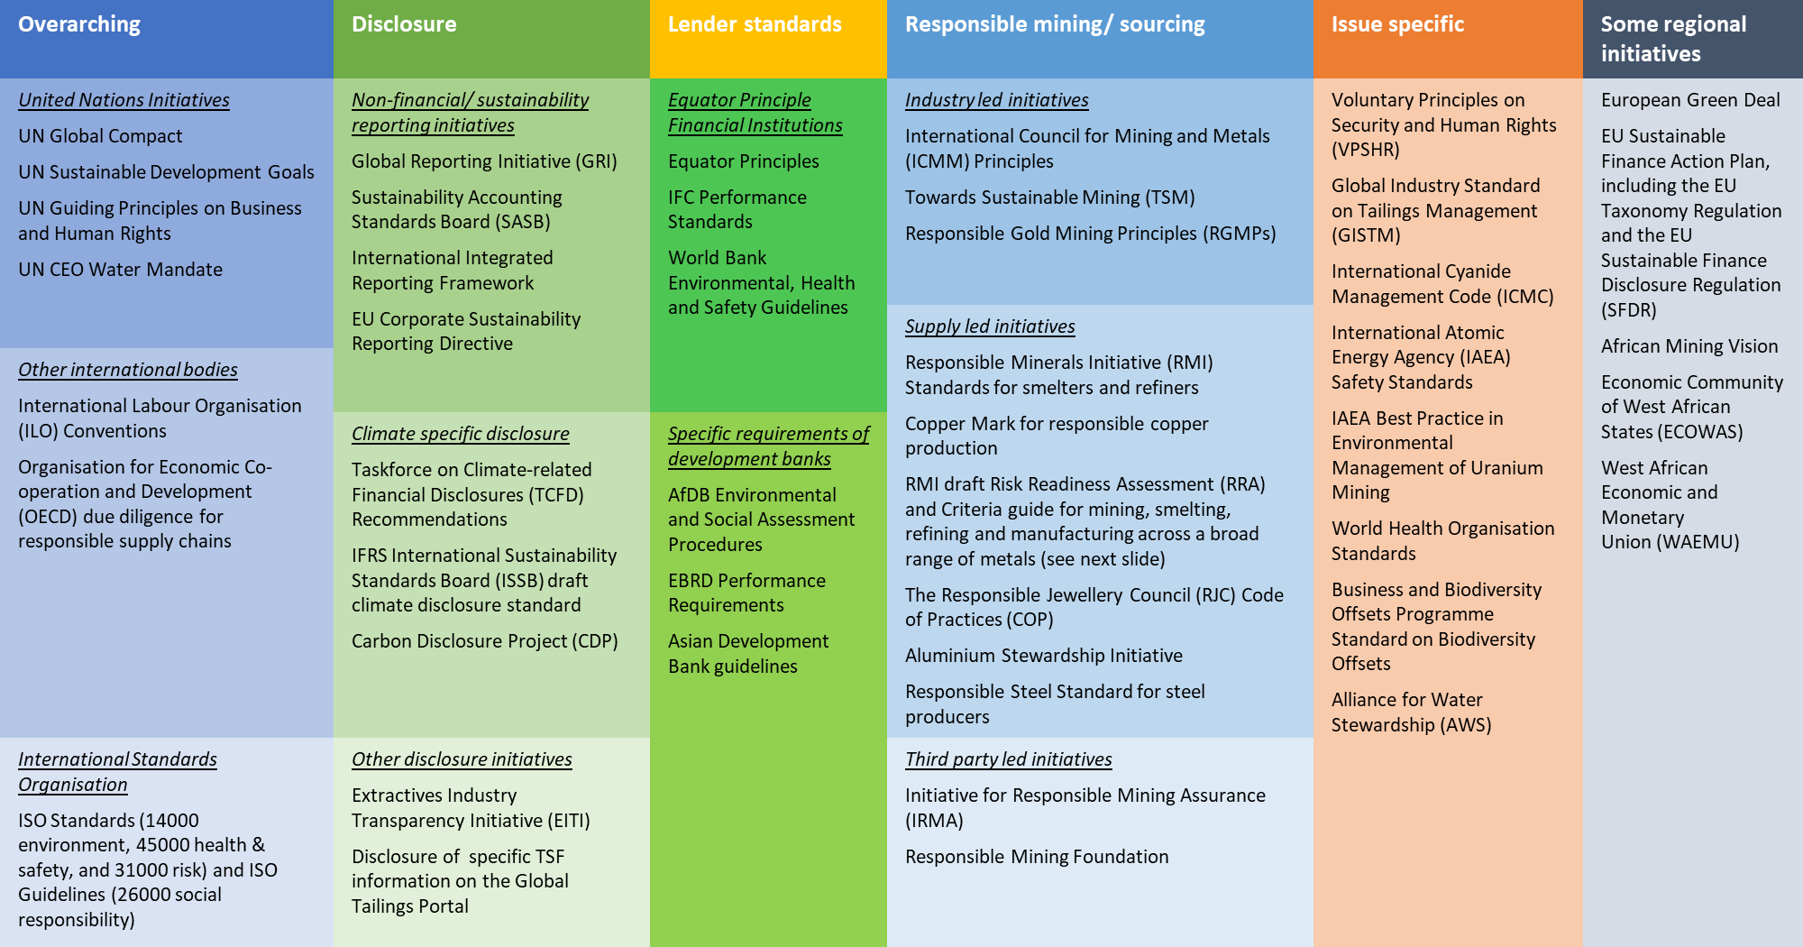
Organised view of key ESG standards relevant to mining

Slide 15
Financial Aspects of Sustainable or Responsible Mining Standards
Some benefits using Sustainable / Responsible Mining Standards include:
Assisting with developing internal sustainability standards, i.e. incorporation or alignment with well researched indicators and benchmarks
Adoption of credible sustainable or responsible standards provide assurance through third-Party verification
Opens access to finance and creates confidence to investors and shareholders
Facilitates Due Diligence, a big rise in specific standards being incorporated into transaction and supply chain due diligence. Facilitates ongoing business
Reduces the risk of weakening ESG when operating in countries that have weak regulatory environments. International alignment and competition.
Reduces internal risk by aligning the company or mine’s ESG policies, values, commitments to its day-to-day operations and creating shared value
Information is readily available for external audits
Information and data is organised and available for new projects, expansions or permitting requirements such as ESIA’s. Avoid duplication of cost and effort
Mine Closure - Timeous closure and reduction in post-closure costs
Cost savings by embracing new technologies – Decarbonisation
Continuous improvement – avoiding inflationary pressures later on
Improve relationships with communities – reduce reputational and legal risk
Water stewardship – shared costs and better results for decision making

Slide 16
Questions and Answers

